Slide 1

Loan Book Principal Balance And Prosucts Analysis

Slide 2
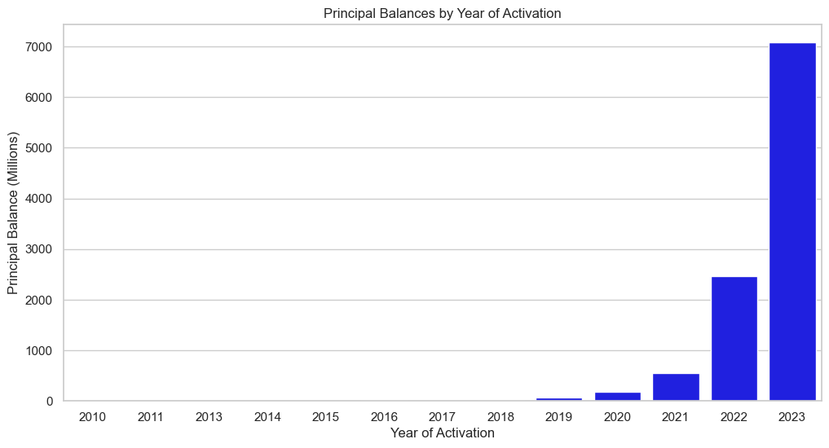
In 2023 the company had the highest sales which marked an upward trajectory from the the previous year, this was attributed to the introduction of new products in the market which saw the company moving to its greater heights closing the year with 7Mn.

Slide 3
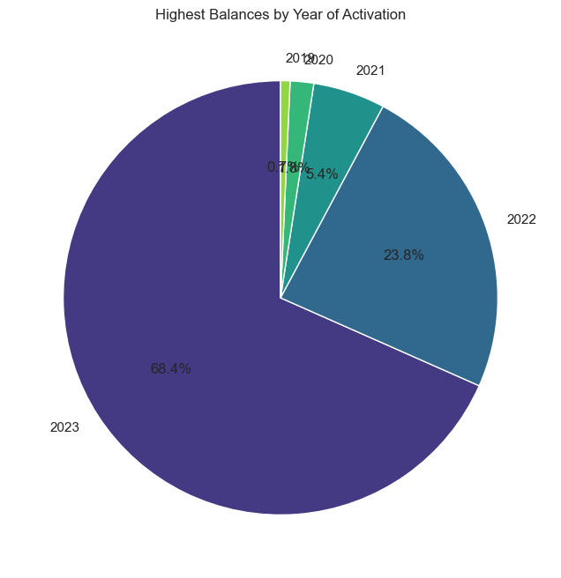
Looking at total Principal balances in 2023,Civil service product registered the higest count,68.4%, Logbook financing following closely at 23.8% followed by other products,The company should see the need of investing further on other products inorder to cushion any future deterances on the shining products

Slide 4
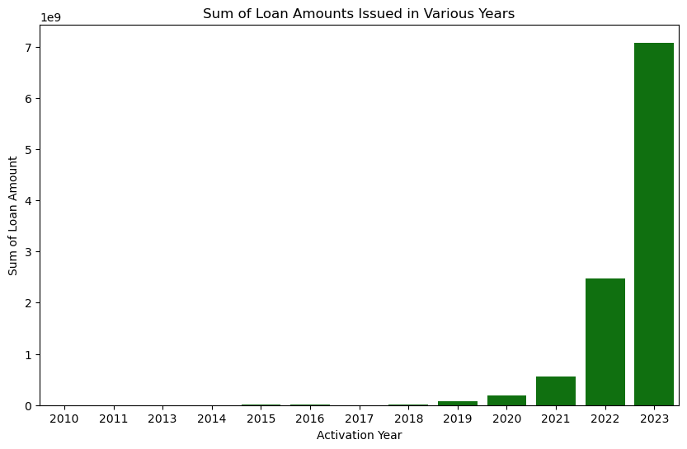
The graphical representation above shows existence of a postive correlation between the principal balance and the year of activation, as the introduction of new products in the market the higher the sales resulting in higher principal balance.

Slide 5
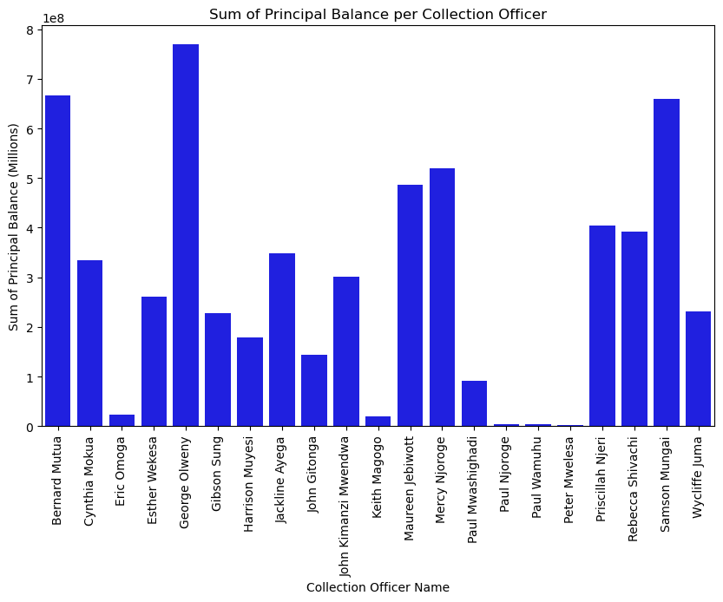
Top Performers: George Olweny, Bernard Mutua, and Rebecca Shivachi stand out as the top-performing collection officers, with the highest sum of principal balances.
Distribution of Workload: There is a notable variation in the sum of principal balances across the collection officers, indicating differences in the workload distribution. This could be attributed to varying client portfolios or levels of efficiency.
Opportunities for Improvement: Collection officers such as Maureen Jebiwott, Paul Wamuhu, and others with comparatively lower sums present opportunities for improvement. Exploring strategies to enhance their performance could lead to a more balanced and optimized distribution of principal balances.
Strategic Planning: The data emphasizes the need for strategic planning in resource allocation and recruitment. Understanding the strengths and weaknesses of each collection officer is crucial for effective decision-making and achieving overall organizational goals.

Slide 6
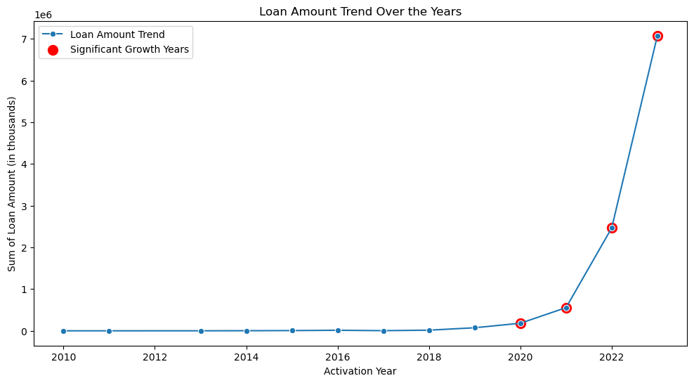
The demand for money in 2023, driven by the new products, resulted in the largest volume of loan hence increased principal balance. However, in the subsequent years the fluctuations were observed due to changes in consumer behavior influenced by harsh economic times, reducing the income and eligibility for an upward trajectory.

Slide 7
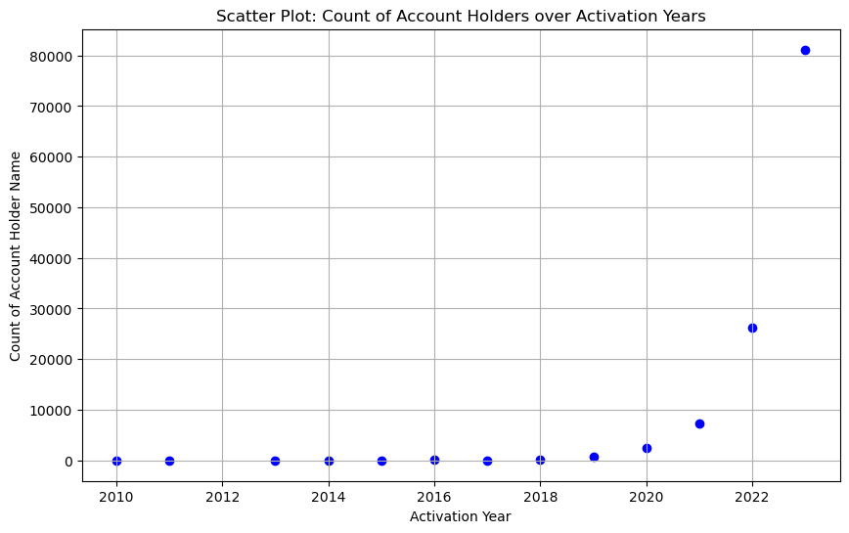
As a business, 2010 to 2016 was not a good year for all the products as number of clients was relative to that of principal balances, however the company registered the highest number of clients in history in 2023.Annual balance to client base ratio was greater than 100% looking at the upward trajectory for the year ending 2023

Slide 8
Future Recommendations
Immediate attention is required to enhance the company's competitiveness and elevate its standing in the market by addressing the increasing number of clients and the principal balance. To achieve this, urgent diversification efforts are crucial, especially amidst the continuously evolving market conditions. Conducting thorough market research is recommended to identify additional offerings that can be introduced when the demand for financial services experiences a downturn.
Improving market visibility is paramount for sustained growth. This involves strategically opening more branches in key locations to enhance visibility and broaden coverage. By doing so, the company can tap into untapped markets, expanding its reach and influence.
To further bolster business growth, a strategic focus on expanding the new business book is recommended. This can be achieved by targeting newly employed individuals and business owners, thereby increasing the overall client base.
Performance Incentives: Consideration of performance incentives tied to principal balance achievements could further motivate the collection team. This could contribute to a more competitive and high-performing work environment.

Slide 9

THE END

